Slide 1
professional Development 3 WHAT IS CULTURAL COMPETENCE? Share what Mindfulness Activity you tried this past week. What did you like/not like about it?
ENGR 4010: Professional Development 3

Slide 2
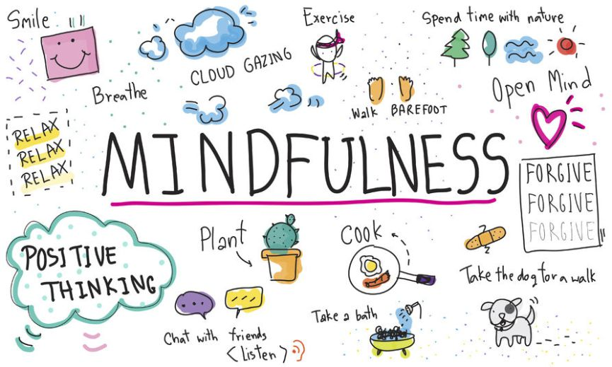

Slide 3
Community Agreements
Speak from the “I” perspective:
Listen actively: Listen to understand, not to respond.
Step up, step back
Respect silence.
Share, even if you don’t have the right words
Uphold confidentiality:
Lean in to discomfort

Slide 4
Core Concepts
Culture
Identity

Slide 5
What is Culture?
The integrated pattern of human knowledge, belief and behavior that depends upon the capacity for learning and transmitting knowledge to succeeding generations.
A set of shared attitudes, values, goals and practices that characterizes a group of individuals or an institution or organization.

Slide 6
What is Culture ?
Culture is the fundamental building block of identity and the development of a strong cultural identity is essential to an individual’s healthy sense of who they are and where they belong

Slide 7
What is Identity?
Distinguishing characteristics.
The condition of being the same with something described or asserted.
Everyone has many identities:
Age Education Level
Gender Ability/Disability
Religion
SES
Race
Sexual Orientation

Slide 8
I AM…
For next 3 minutes… write three sentences beginning with I am

Slide 9
Social Identity Wheel Activity
Objective The purpose of this activity is to explore the diversity among the members of our community. How a person identifies can affect many facets of his or her life. We will use this activity to get to know one another on a deeper level. What are our values, backgrounds, and visible and invisible labels? This activity requires everyone to step outside of his or her comfort zone. Participants being vulnerable can help the group learn more about the identities they do not share.

Slide 10
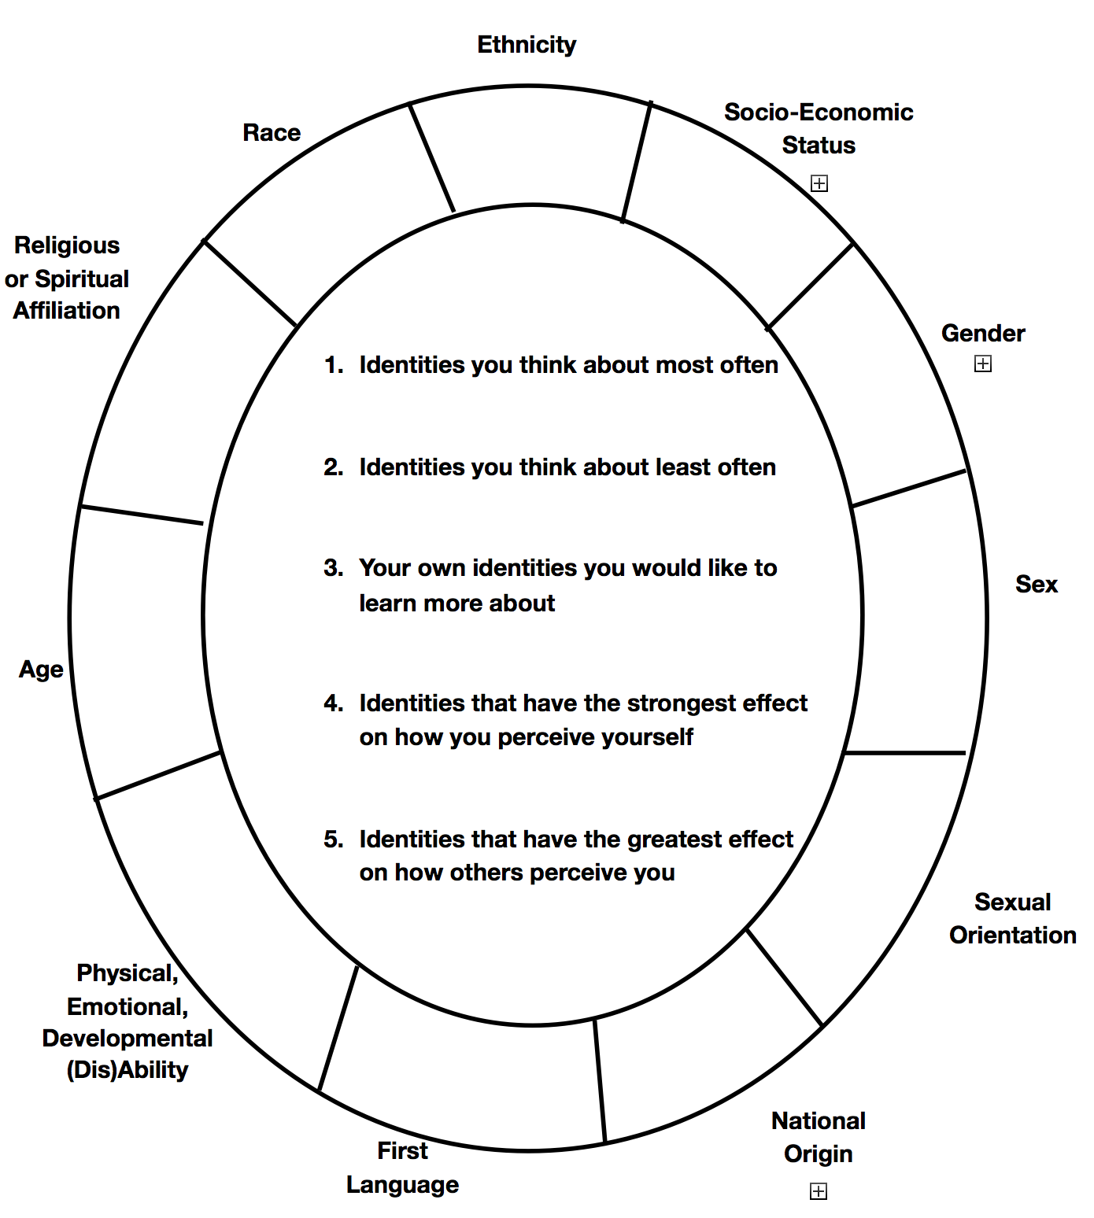

Slide 11
“I am…” Statements & Social Identity Wheel
What social identities, if any, showed up in your I AM statements? Are they the identities you think about most often in relation to yourself? When you think about how others perceive you? Both?
Are there social identities located on the wheel you have that were not included in your I AM statements? Why do you think that is?

Slide 12
Group Discussion Questions
Which aspects of your social identity feel especially meaningful to you and why?
Which aspects of your social identity don’t feel as meaningful to you and why?
Are there any that you hadn’t thought of before today, and if so, why do you think that is?
What experiences have you had that make the identities in your inner circle more salient to you?
Why do you think more about some of your identities than others?
How do your identities influence your sense of belonging in RPI and other groups that you’re part of?

Slide 13
Discussion
How Does your Identity Afford You Privilege in Everyday Life?
Which Aspects of your Identity are Socially More Powerful and which Aspects are Socially More Marginalized.
Are Each of your Identities:
Visible or Invisible
Permanent or changeable
Inborn or Chosen

Slide 14
What is culture?
Nations
Social class
Racial groups
History
Customs
Experiences
Rituals
Food
Holidays
The growth of group identity fostered by social patterns unique to that group
Traditions
Notions of time
Storytelling
Space
Language
Attire
Music
Generations
Religious groups
Gender

Slide 15
Which of these are not cultural groups
Deaf Americans
Native Americans
African- Americans
White Americans
LGBT Q Americans

Slide 16
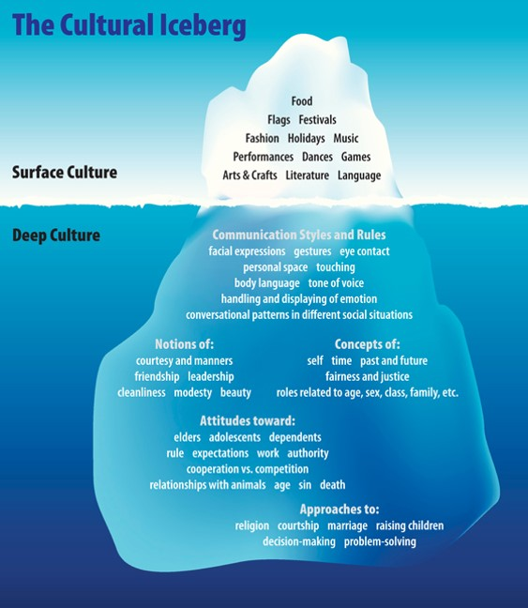

Slide 17
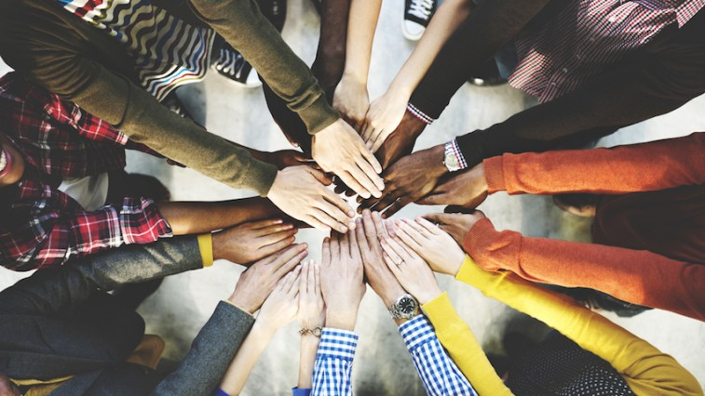
Cultural Competence is…

Slide 18
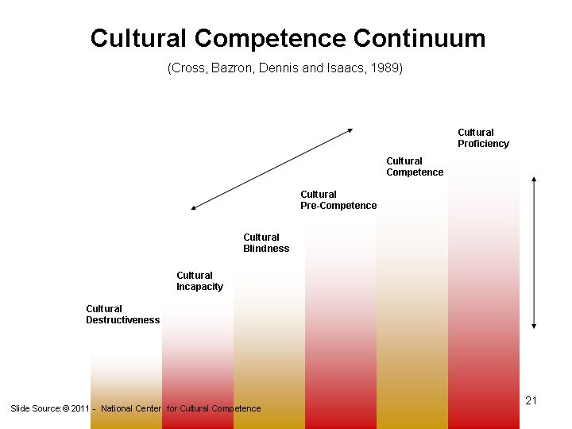

Slide 19
1. Cultural Destructiveness “We are all that is important”
Individuals make a conscious effort to destroy cultures that are different from one’s own or from what one thinks will work best for others
Characteristics:
Extreme biases against those who are different
Overt message to others is they are not welcome or valued
Others are nonentities or expendable
Absolutist world view values winning at all costs

Slide 20
2. Cultural Incapacity “We take care of our own”
Individual or group is unwilling to be useful or helpful to other culture.
Characteristics:
Not consciously incapacitated but simply taking care of their group
Stuck in mindless position: simply not aware of behavior that maintains this incapacitated state. Outsiders will experience subtle messages that they are not welcome or valued
Disproportionately apply resources to benefit own group
Those who are different are segregated for their own good

Slide 21
3. Cultural Denial/Indifference “All people are the same”
Belief that culture/color and dimensions of diversity are unimportant
Characteristics:
Encourages assimilation and suppression of difference
Discomfort recognizing difference/ignores cultural strengths
Does not recognize the reality of power and privilege
Beliefs, policies and actions assume world is fair and achievement is based solely on merit
What is good for dominant group is universally applicable and applies to all

Slide 22
4. Cultural Pre-Competence “Limited action but trying”
Individuals are coming to see how their actions have been cultural destructive but are trying to understand how to act culturally competent
Characteristics:
Works at being inclusive
Expresses commitment to human/civil rights
Beginning to understand how ethnocentric beliefs can distort one’s vision
Beginning to question the validity of segregation and or assimilation
Maintains a parental attitude toward the marginalized group

Slide 23
5. Cultural Competence “Fostering mutual adaptation to difference to create environments useful for all”
Cultural competence is characterized by a commitment to social and economic justice
Characteristics:
Actively develops cross-cultural knowledge and skills
Mindfully behaves in a manner that demonstrates a value for diversity
Demonstrated commitment to human/civil rights, social justice as defined by the marginalized group
Willingness to stay engaged with others to integrate their values , beliefs and associated needs into decision making and action

Slide 24
6. Cultural Proficiency “Optimal, universal, inclusive and proficient”
Hold culture in high esteem and that is one’s organizing frame of reference and the foundation by which one understands relationships between individuals, groups, organizations and systems.
Characteristics:
Worldview shifts from absolutist/ethnocentric to universalism
Attitude shifts from judgement to compassion and generosity
Relationships shift from stereotyping to authentic
Practice shifts from destructive to constructive
Policy shifts from exclusionary to inclusionary

Slide 25
Group 1: Incapacity
Group 2 : Competence
Group 3: Destructiveness;
Group 4: Blindness
Group 5: Pre-competence;
Group 6: Proficiency

Slide 26
Small Group Activity
Please find TWO examples of your assigned cultural competence continuum stage within the news, media, professional organizations, institutions, and companies.
Try to find at least ONE relating to your assigned Cultural Competency Presentation Topic
Be prepared to share your examples and how they illustrate this stage of Cultural Competence to the large group.

Slide 27
Team Assignments- Cultural Competency
Team 1- Cultural Incapacity; Inter-generational Diversity
Team 2- Cultural Competence; Gender Identity Diversity
Team 3- Cultural Destructiveness; Race &Ethnic Diversity
Team 4- Cultural Pre-Competence; Communication
Team 5- Cultural Blindness; Difference in the Workplace
Team 6- Cultural Proficiency; Engineering Design & Diversity

Slide 28
Cultural Competence enables a person to…
Value the differences/similarities between persons and groups
Make the knowledge of a culture a part of oneself
Focus on one’s strengths and capacities
Recognize the importance of a person’s life context

Slide 29
Stereotyping as Fallacy
All millennials use social media.
Diana uses social media.
Therefore, Diana is a millennial.
All millennials use social media.
Guillermo does not use social media.
Therefore, Guillermo is not a millennial.

Slide 30
Cultural Competency Presentation
See Handout- should be 25 minutes long
Based on articles assigned on LMS
Need to find 3 additional PEER-REVIEWED articles
Can put together video/prezi/powerpoint
Must provide digital copy to me by START OF CLASS
Submit via LMS by one team member only!

Slide 31
Cultural Competency Presentation
See LMS- should be 20-25 minutes long
Based on articles assigned on LMS
Need to find at least 3 additional PEER-REVIEWED articles
Go beyond article summary and be sure to address critical thinking questions in the assignment
Must include an interactive activity component lasting ≥5 minutes that helps the class engage with the material being presented
Can put together video/prezi/powerpoint
Must provide digital copy to me by START OF CLASS
Submit via LMS by one team member only!
Presentations will be in class on 7/31- (Teams 1, 2, 3) & 8/3 (Teams 4, 5, )

Slide 32
Cultural Competency Presentation
See LMS documents- should be 25 minutes long
Based on articles assigned on LMS
Need to find at least 3 additional PEER-REVIEWED articles
Can put together video/prezi/powerpoint
Must provide digital copy to me by START OF CLASS
Submit via LMS by one team member only!

